Slide 1
Trigonometry
Angles 0f Elevation and Depression

Slide 2

Example 1: An electricity pylon stands on horizontal ground. At a point 80m from the base of the pylon, the angle of elevation of the top of the pylon is 23$°$. Calculate the height of the pylon to the nearest metre.

Slide 3

Example 2: A surveyor measures the angle of elevation of the top of a building as 19$°$. She moves 120m nearer the building and finds the angle of elevation is now 47$°$. Determine the height of the building.

Slide 4
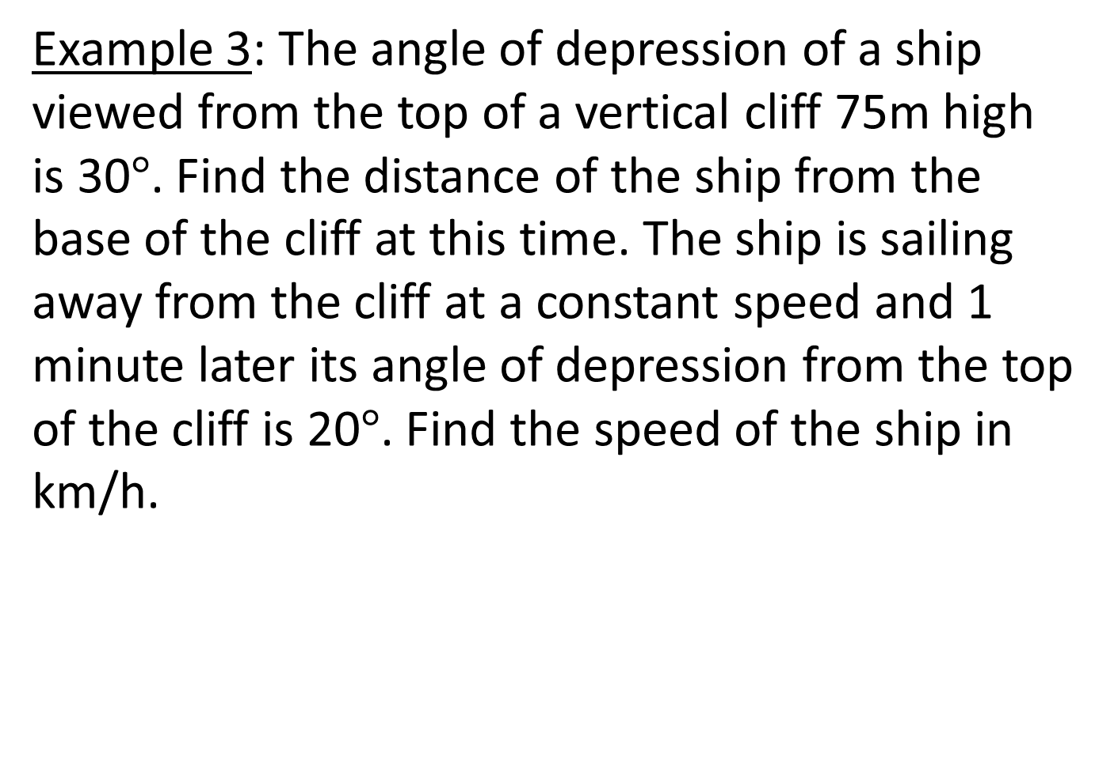
Example 3: The angle of depression of a ship viewed from the top of a vertical cliff 75m high is 30$°$. Find the distance of the ship from the base of the cliff at this time. The ship is sailing away from the cliff at a constant speed and 1 minute later its angle of depression from the top of the cliff is 20$°$. Find the speed of the ship in km/h.

